Slide 1

Internship Presentation On work Done in
“Saint Gobain”
Submitted by: Mentored by:
Virender Singh Fahim Mohammad
National Institute of Technology Hamirpur Sai Teja

Slide 2
Contents:
Internship Project Outcomes:
Quantitative and qualitative analytics to develop regional insights about potential IHB Customers and Influencers to propose a detailed plan of action that will result in better reach and higher sales.
Project Phases:
To understand what type of Windows product Saint Gobain delivers and what are the different problems that one can face with Windows.
How UPVC windows and profiles are manufactured.
To do a complete benchmarking on Saint Goabin Windows Home Website and Some Indian and International websites.
To collect Sales data from Saint Gobain windows Sales team and obtain some useful insights by analysing the collected data that help to increase windows sale.
What I learn during the Internship?

Slide 3
Internship Goals
To find out what are the various problems that an individual can face with windows.
To understand how the UPVC windows and UPVC profiles are manufactured in the plant
To do complete benchmarking on Saint Gobain Windows Home website and some Indian and International Windows websites and to find out the ways how to improve the Saint Gobain windows home website.
To collect Sales data related to the various opportunities raised by the sales team of Saint Gobain , analysis the data and provide regional insights that will help to increase customer reach and sales

Slide 4
Recommendations to improve Saint Gobain Windows Home website
Provision for finding the dealer and or contractor nearby the locality
Feedback provision for the customers.
Searching provision to find the right product
Price or Cost estimator that helps customer to have an idea about the overall project cost.
Recent project Gallery and testimonials
Product buying and installation guide.

Slide 5

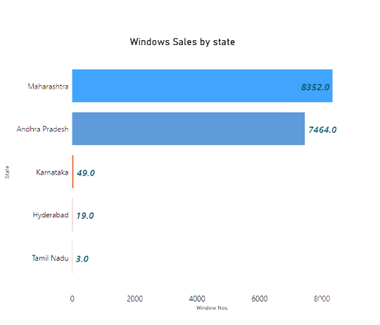
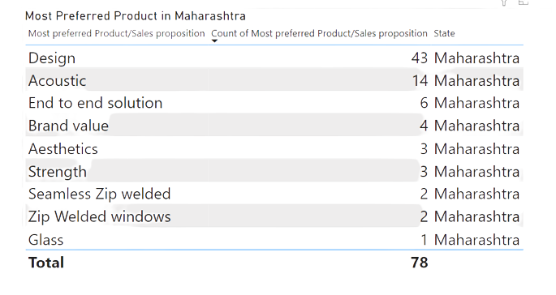
Data Analytics Part Maharashtra Region
Which type of product features are preferred more in Maharashtra

Slide 6
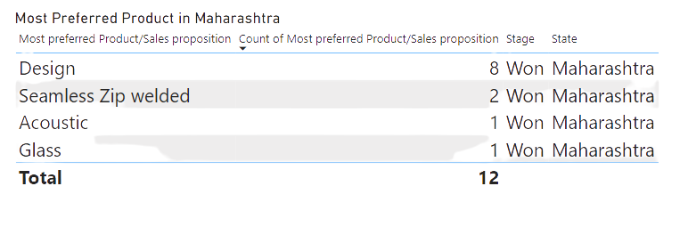
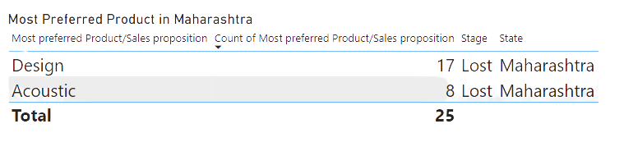
What type of product features we are able to won most and what type of products features we lost most in Maharashtra region
Design won %age = 18.61%
Design loss %age = 39.54%
Rest are in Active state (41.85%)
Acoustic won %age = 7.14%
Acoustic loss %age = 57.14%
Rest are in Active state (35.52%)

Slide 7
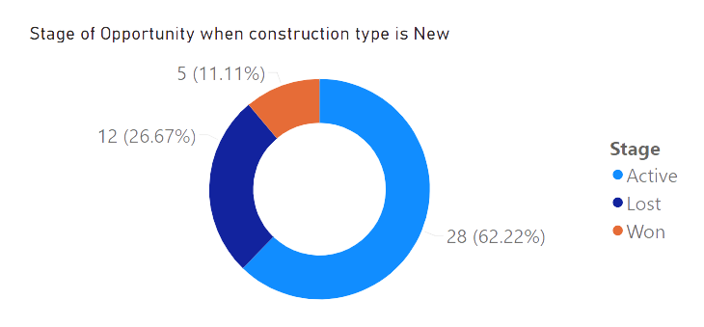
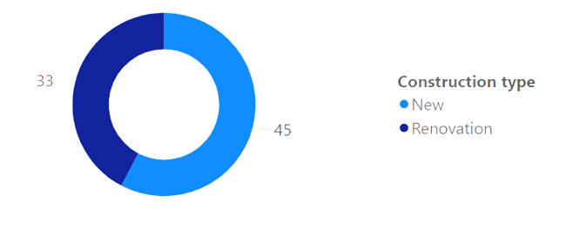
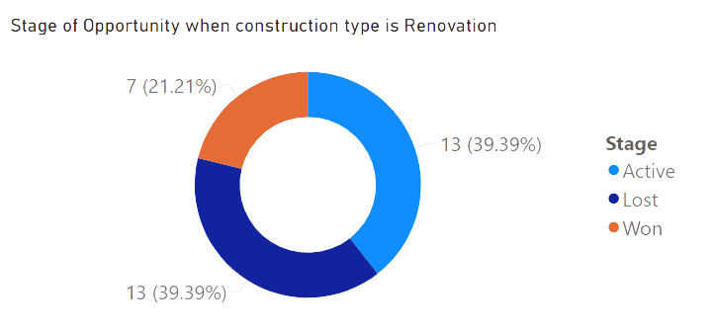
Analysis based on Construction Type
More opportunities are won when the construction type is Renovation
More opportunities are in active stage when the construction type is New

Slide 8
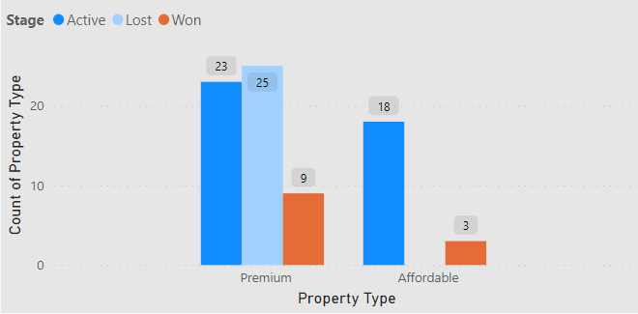
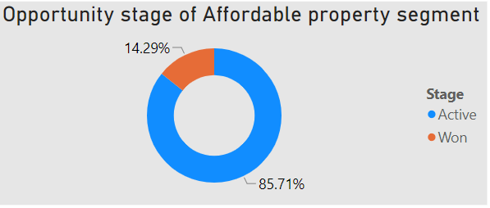
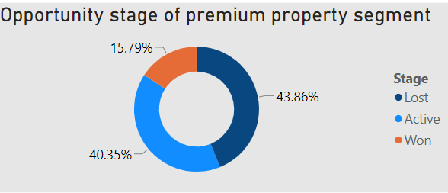
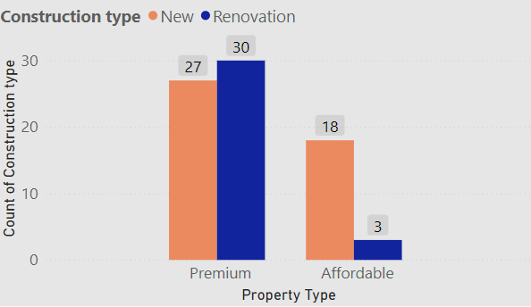
Analysis based on property segment
In affordable segment won percentage is less as compared to premium segment because of less opportunities in renovation construction type.

Slide 9
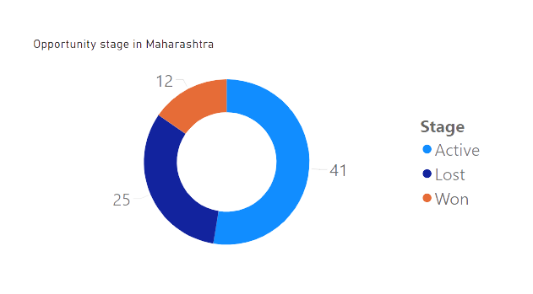
How many Opportunities are in Active, Won and Lost stage in Maharashtra
Reasons for Opportunities in active stage
Total Window area of Opportunity is very high(around 5000 sq feet)
Very less influencer are involved.
Reasons for Lost Opportunities
Total Window area of Opportunity is very less(around 300 sq feet)
Price per sq feet is too high
Reasons for won Opportunities
Construction type is renovation
More influencers are involved

Slide 10
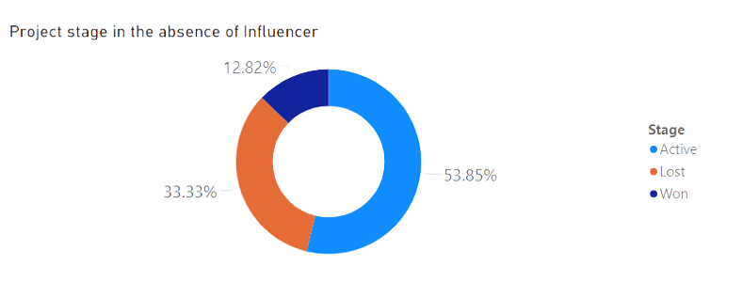
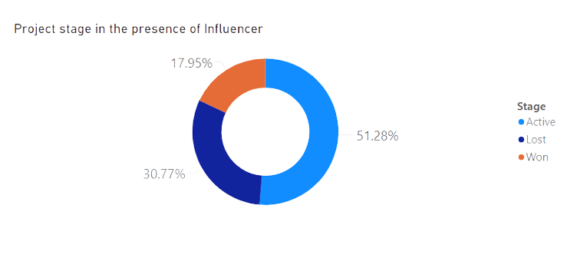
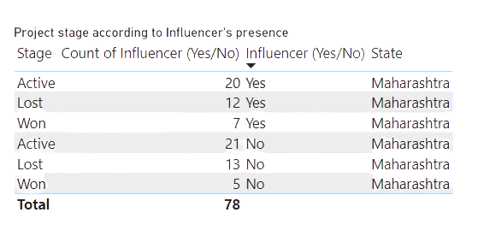
Effect of Influencers on the sales in Maharashtra region
Won %age in presence of influencer = 17.95%
Loss %age in presence of influencer = 30.775%
Won %age in absence of influencer = 12.82%
Loss %age in absence of influencer = 33.33%

Slide 11
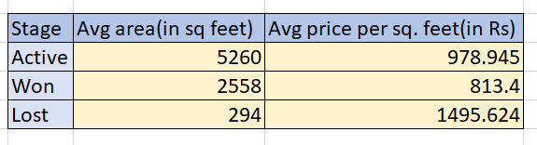
Analysis based on Window Area in Maharashtra region
Opportunities having very less average area and high price per sq feet are lost

Slide 12
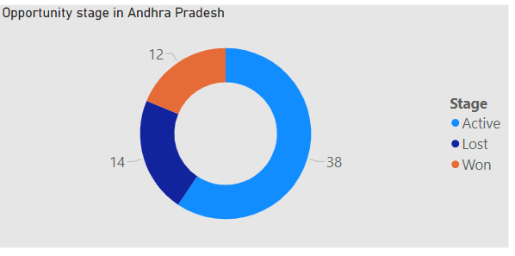
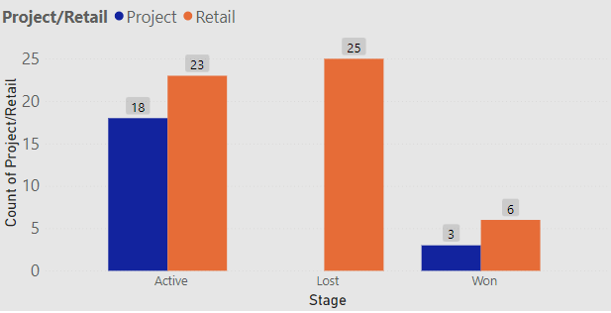
Andhra Pradesh region
How many Opportunities are in Active, Won and Lost stage in Andhra Pradesh
Reason for Lost Opportunities: Retail work

Slide 13
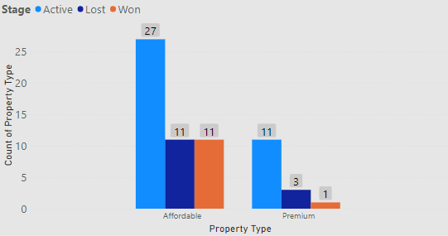
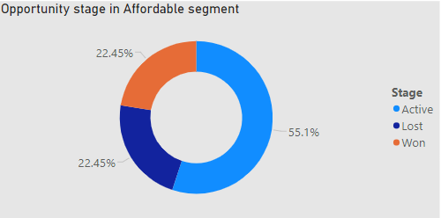
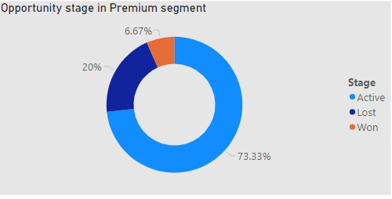

Analysis based on property segment
Reason for not winning Premium segment opportunities:
More price per sq feet for less area

Slide 14
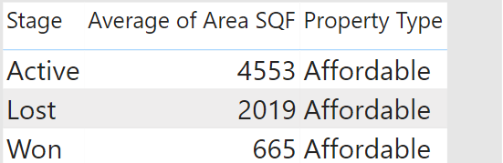
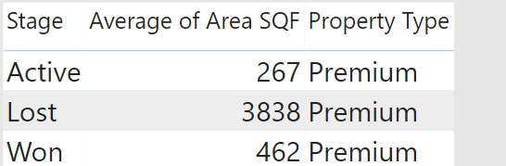
Analysis based on Window Area
In both the property type only those opportunities are won which are having less project area(window area)

Slide 15
My internship learnings
How UPVC windows and UPVC profiles and How are they manufactured.
Improve websites by doing a detailed benchmarking with the competitors.
Collecting data from the sales team and then analysis data using some powerful business tools like Microsoft Power Bi.
How to work as a team and find solutions to the problems that arises during the work.
Obtaining insights that helps to increase reach and sales of the products.

